Slide 1
CHAPTER
5
Diffusion
5-1

Slide 2
Atomic Diffusion in Solids
Diffusion is a process by which a matter is transported through another material.
Examples:
      Movement of smoke particles in air : Very fast.
      Movement of dye in water : Relatively slow.
      Solid state reactions : Very slow because of bonding.
5-2

Slide 3
Vacancy or Substitutional Diffusion mechanism
Atoms diffuse in solids if
      Vacancies or other crystal defects are present
      There is enough activation energy
Atoms move into the vacancies present.
More vacancies are created at higher temperature.
Diffusion rate is higher at high temperatures.
5-3

Slide 4
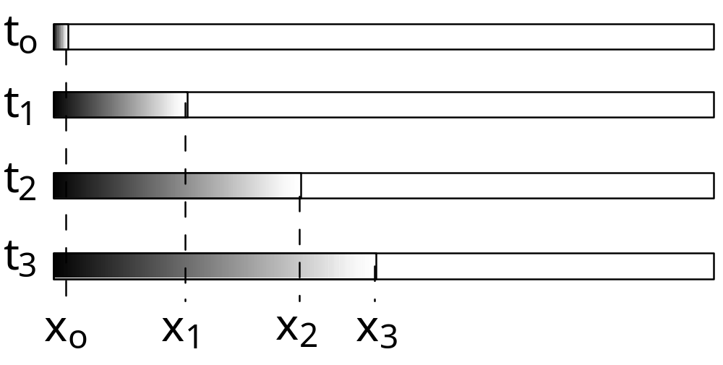
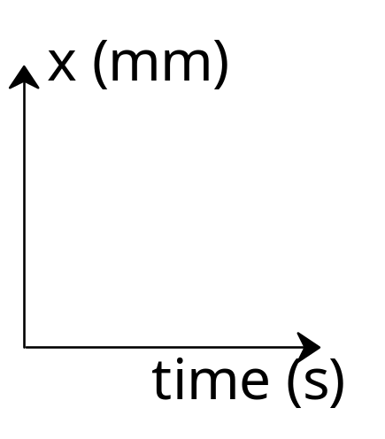
DIFFUSION DEMO
• Glass tube filled with water.
• At time t = 0, add some drops of ink to one end
of the tube.
• Measure the diffusion distance, x, over some time.

Slide 5


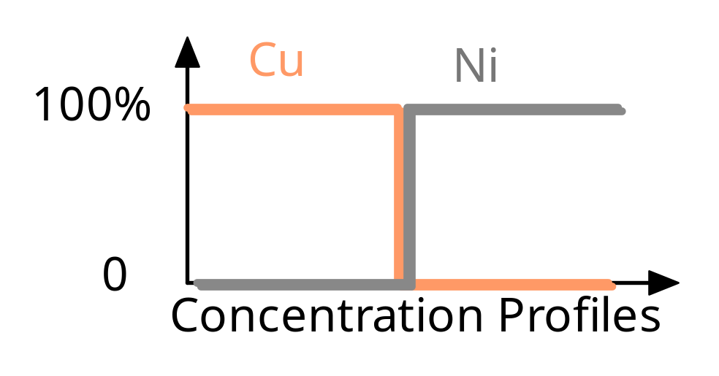
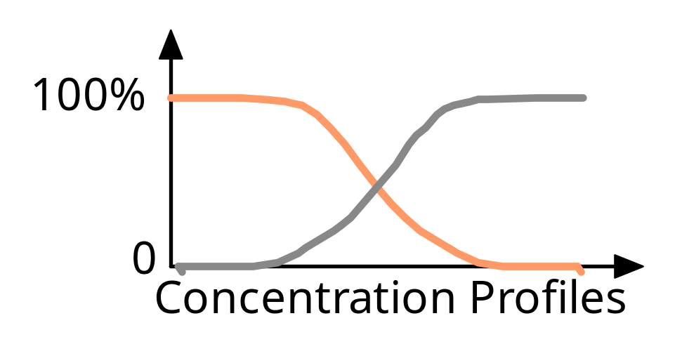
DIFFUSION: THE PHENOMENA (1)
• Interdiffusion: In an alloy or “diffusion couple”, atoms tend
to migrate from regions of large to lower concentration.
Initially (diffusion couple)
After some time
Adapted from Figs. 5.1 and 5.2, Callister 6e.

Slide 6
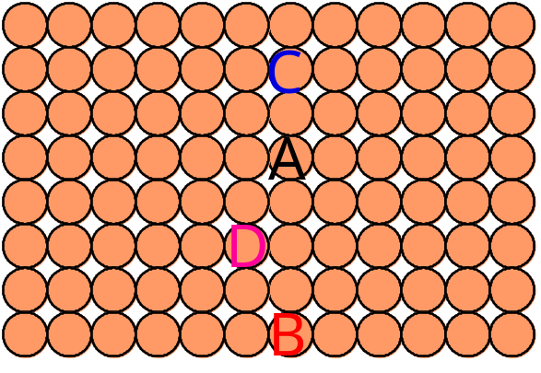
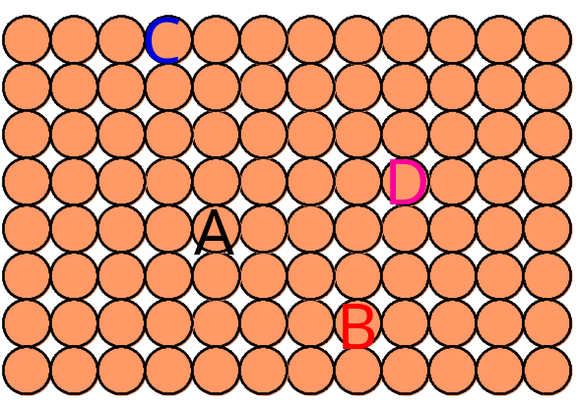
DIFFUSION: THE PHENOMENA (2)
• Self-diffusion: In an elemental solid, atoms
also migrate.
Label some atoms
After some time

Slide 7
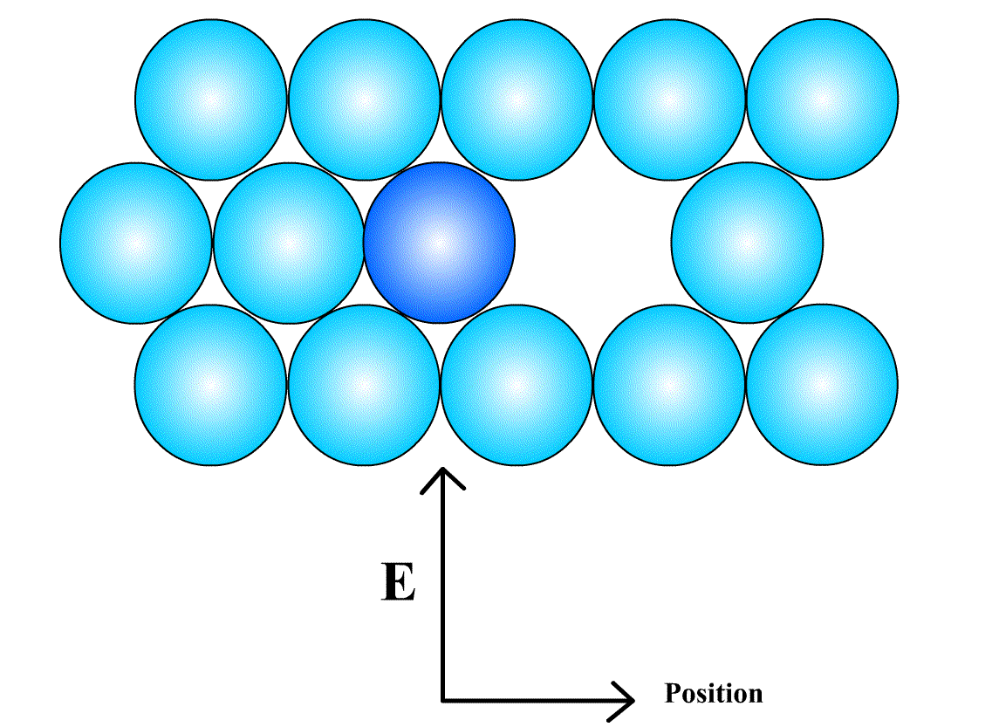
Substitutional Diffusion
Example: If atom ‘A’
has sufficient activation
energy, it moves into the
vacancy self diffusion.
As the melting point increases, activation energy also
increases
Activation
Energy of
Self diffusion
Activation
Energy to
form a
Vacancy
Activation
Energy to
move a
vacancy
=
+
Figure 4.35
5-4

Slide 8
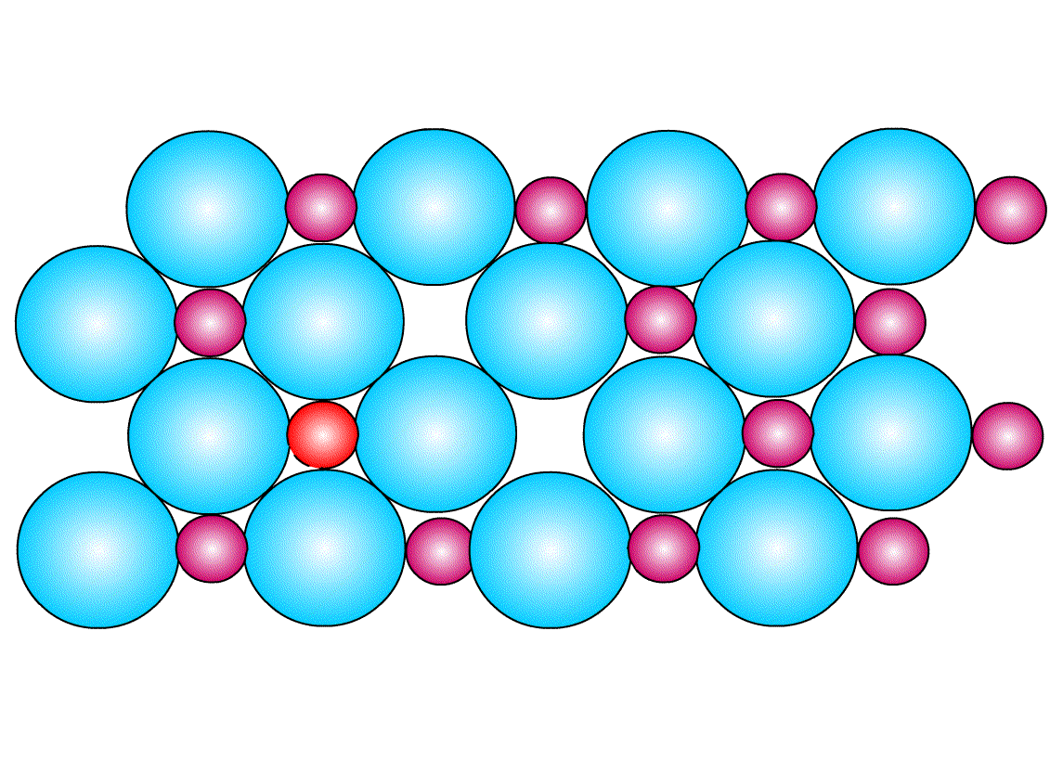
Interstitial Diffusion mechanism
Atoms move from one
interstitial site to another.
The atoms that move must
be much smaller than the
matrix atom.
Example:
Carbon interstitially
diffuses into BCC α or FCC
γ iron.
Interstitial atoms
Matrix
atoms
Figure 4.37
5-5

Slide 9
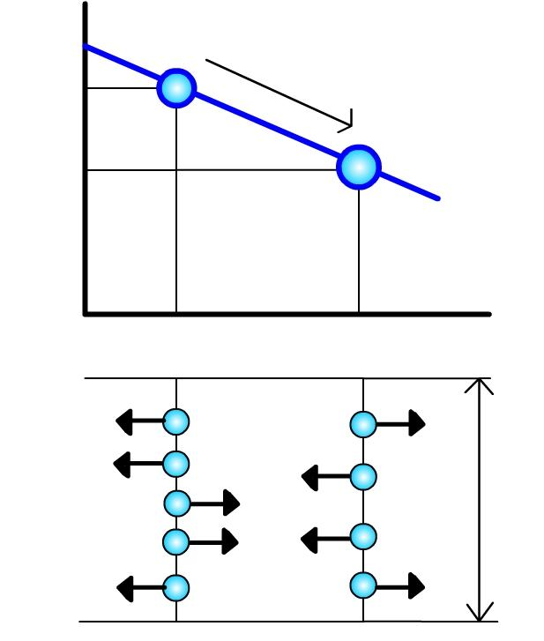
Steady State Diffusion
There is no change in concentration of solute atoms at different planes in a system, over a period of time.
No chemical reaction occurs. Only net flow of atoms.
C₁
Solute atom flow
Concentration
Of diffusing
atoms
C₂
Distance x
Net flow of atoms
Per unit area per
Unit time = J (the flux)
Units m⁻²s⁻¹
Diffusing
atoms
Unit
Area
Figure 4.38
5-6

Slide 10
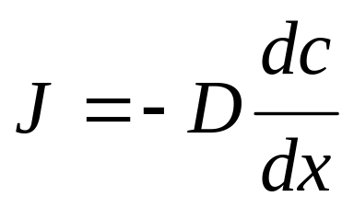

Fick’s Law
The flux or flow of atoms is given by
i.e. for steady state diffusion condition, the net flow of atoms by atomic diffusion is equal to diffusion D times the diffusion gradient dc/dx .
Example: Diffusivity (Diffusion Coefficient) of FCC iron at 500ºC is 5 x 10⁻¹⁵ m²/S and at 1000ºC is 3 x 10⁻¹¹ m²/S (4 orders of magnitude greater)
J = Flux or net flow of atoms.
D = Diffusion coefficient. (m²s⁻¹)
= Concentration Gradient. (m⁻⁴)
5-7

Slide 11
Diffusivity
Diffusivity depends upon
    Type of diffusion : Whether the diffusion is interstitial or substitutional.
    Temperature: As the temperature increases diffusivity increases.
    Type of crystal structure: BCC crystal has lower Atomic Packing Factor than FCC and hence has higher diffusivity.
    Type of crystal imperfection: More open structures (grain boundaries) increases diffusion.
    The concentration of diffusing species: Higher concentrations of diffusing solute atoms will increase diffusivity.
5-8

Slide 12
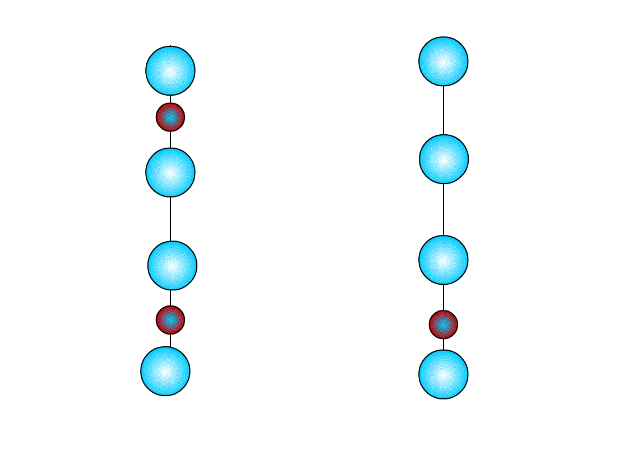
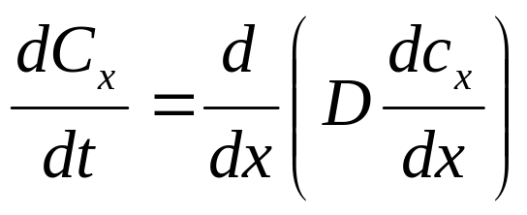
Non-Steady State Diffusion
Concentration of solute atoms at any point in metal changes with time in this case.
Ficks second law:- Rate of compositional change is equal to diffusivity times the rate of change of concentration gradient.
Plane 1
Plane 2
Change of concentration of solute
Atoms with change in time in different planes
5-9

Slide 13
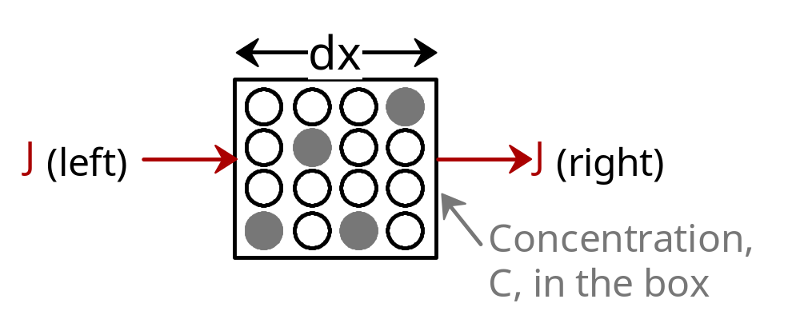
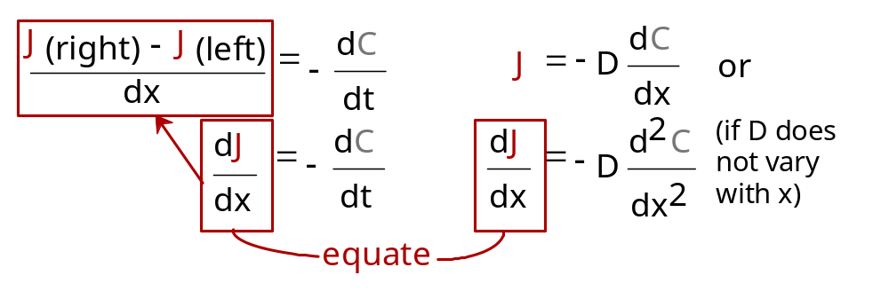
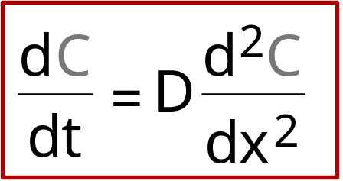
NON STEADY STATE DIFFUSION
• Concentration profile,
C(x), changes
w/ time.
• To conserve matter:
• Fick's First Law:
• Governing Eqn.:
Fick’s second law

Slide 14

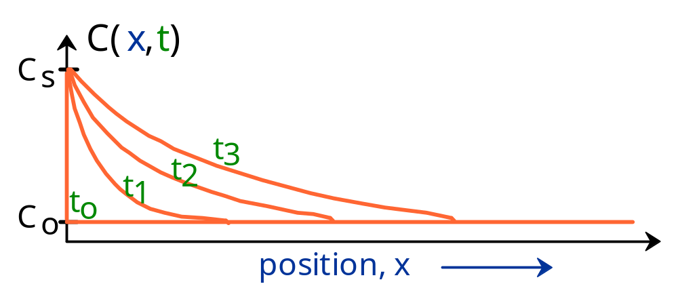
EX: NON STEADY STATE DIFFUSION
• Copper diffuses into a bar of aluminum.
Adapted from Fig. 5.5, Callister 6e.
• Boundary conditions:
For t = 0, C = C₀ at x > 0
For t > 0, C = C_{s} at x = 0
C = C₀ at x = ∞

Slide 15
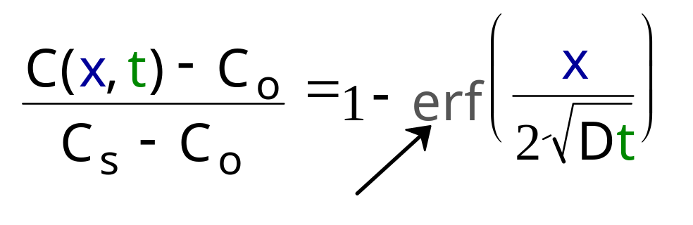
EX: NON STEADY STATE DIFFUSION
• Copper diffuses into a bar of aluminum.
Adapted from Fig. 5.5, Callister 6e.
• General solution:
"error function"
.

Slide 16
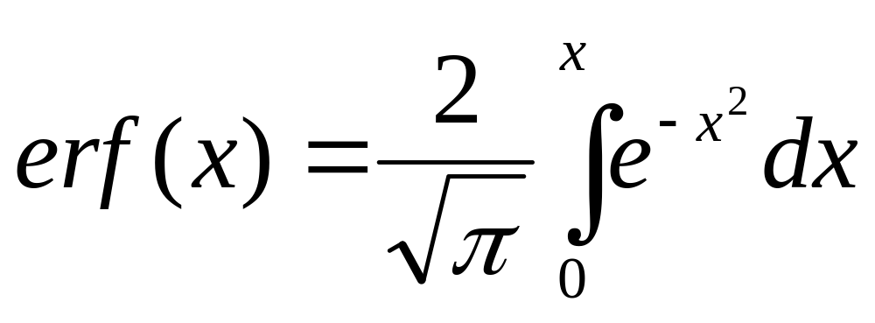
Error Function

Slide 17
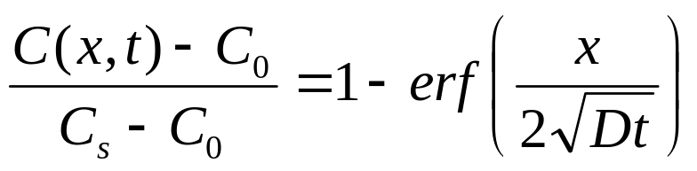
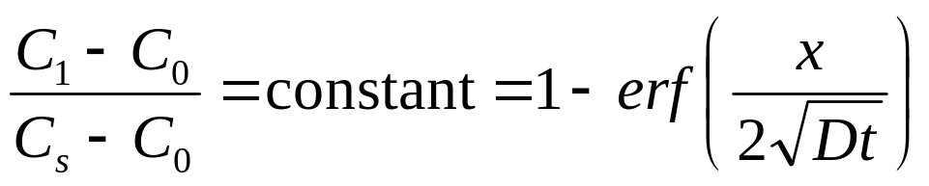
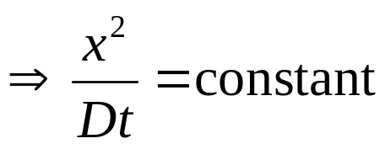
PROCESS DESIGN EXAMPLE
• Suppose we desire to achieve a specific concentration C1 at a certain point in the sample at a certain time
becomes

Slide 18
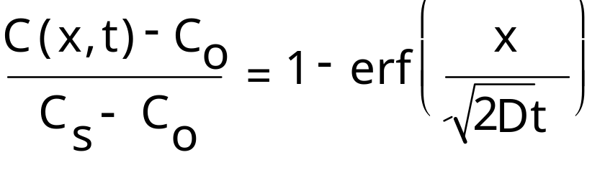
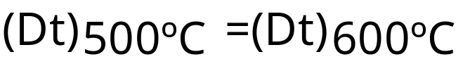
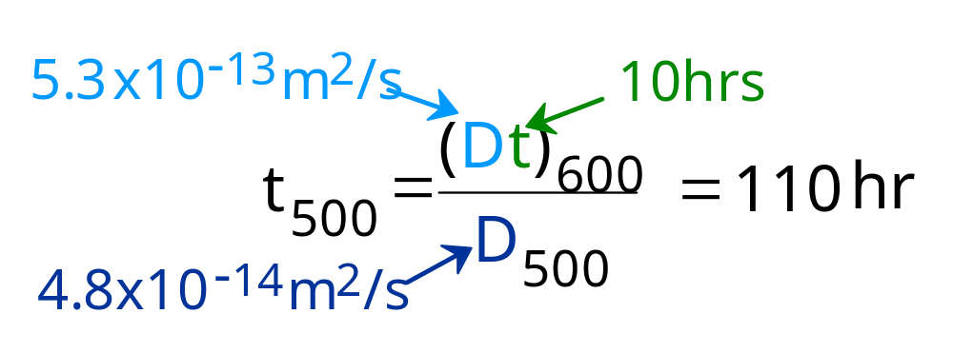
PROCESSING QUESTION
• Copper diffuses into a bar of aluminum.
• 10 hours at 600C gives desired C(x).
• How many hours would it take to get the same C(x)
if we processed at 500C, given D₅₀₀ and D₆₀₀?
Key point 1: C(x,t_{500C}) = C(x,t_{600C}).
Key point 2: Both cases have the same C_{o} and C_{s}.
• Result: Dt should be held constant.
Note: values
of D are
provided here.
• Answer:

Slide 19
Industrial Applications of Diffusion – Case Hardening
Sliding and rotating parts needs to have hard surfaces.
These parts are usually machined with low carbon steel as they are easy to machine.
Their surface is then hardened by carburizing.
Steel parts are placed at elevated temperature (927⁰C) in an atmosphere of a hydrocarbon gas such as methane(CH₄).
Carbon diffuses into iron surface and fills interstitial space to make it harder.
5-11

Slide 20
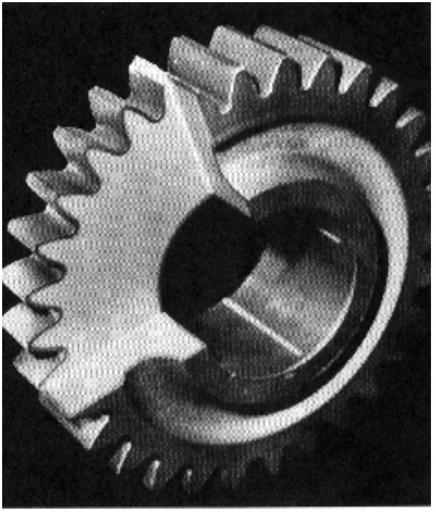
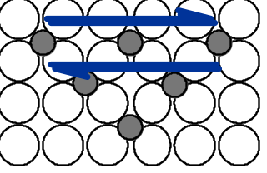
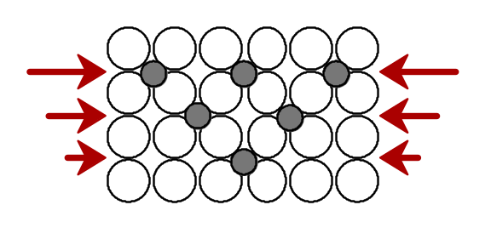
PROCESSING USING DIFFUSION (1)
• Case Hardening:
-- Example of interstitial
diffusion is a case
hardened gear.
-- Diffuse carbon atoms
into the host iron atoms
at the surface.
Fig. 5.0, Callister 6e.
(Fig. 5.0 is
courtesy of
Surface Division, Midland-Ross.)
• Result: The "Case" is
--hard to deform: C atoms
"lock" planes from shearing.
--hard to crack: C atoms put
the surface in compression.

Slide 21
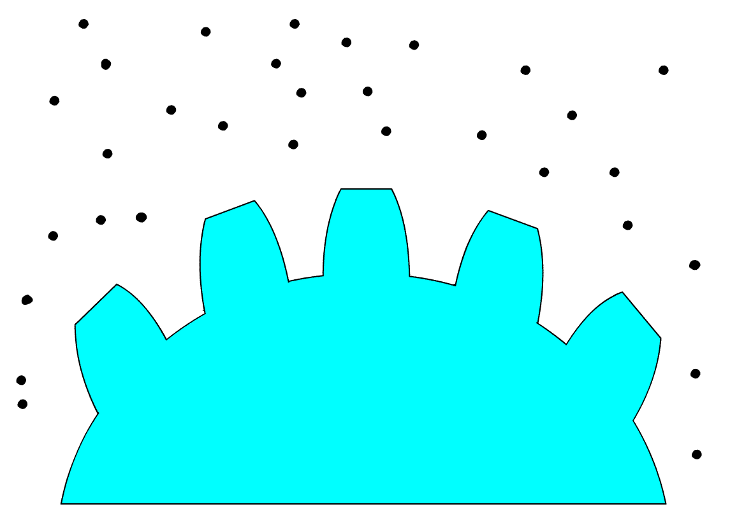
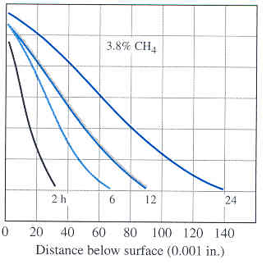
Carburizing
C %
Low carbon
Steel part
Diffusing carbon
atoms
Figure 4.43 b
Carbon Gradients
In Carburized metals
5-12
(After “Metals handbook,” vol.2: “Heat Treating,” 8th ed, American Society of Metals, 1964, p.100)

Slide 22
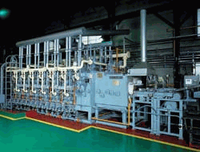
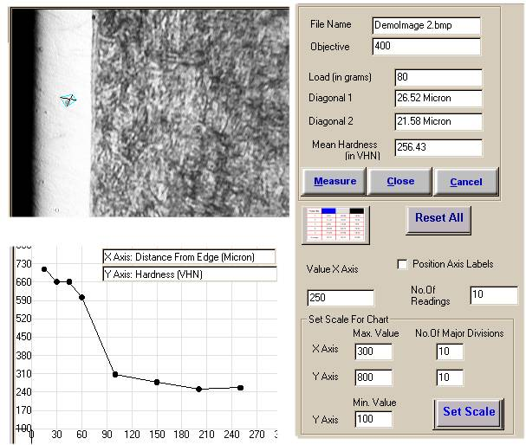

Carburizing
Carburizing Furnace
Carburized Gear

Slide 23
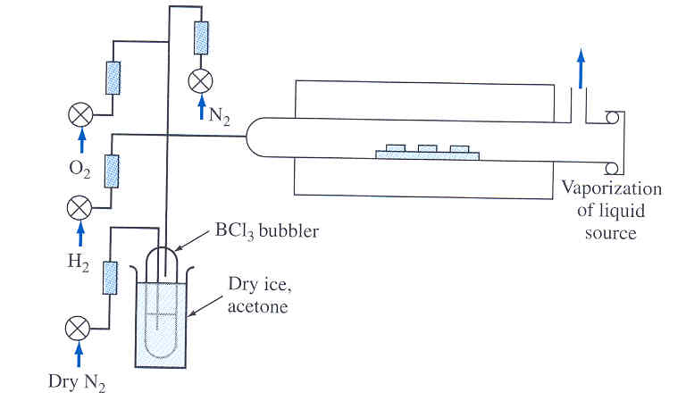
Impurity Diffusion into Silicon wafer
Impurities are made to diffuse into silicon wafer to change its electrical characteristics.
Used in integrated circuits.
Silicon wafer is exposed to vapor of impurity at 1100⁰C in a quartz tube furnace.
The concentration of
impurity at any point
depends on depth and
time of exposure.
Figure 4.44
5-13
(After W.R. Runyan, “ Silicon Semiconductor Technology,” McGraw-Hill, 1965.)

Slide 24
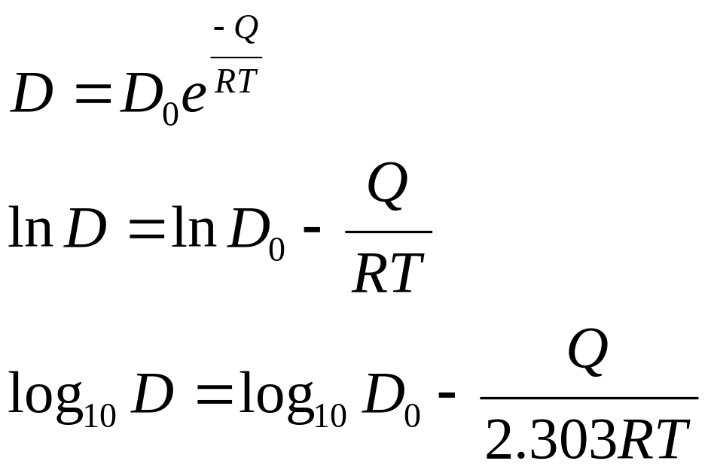
Effect of Temperature on Diffusion
Dependence of rate of diffusion on temperature is given by
D = Diffusivity m²/s
D₀ = Proportionality constant m²/s
Q = Activation energy of diffusing
species J/mol
R = Molar gas constant = 8.314 J/mol.K
T = Temperature (K)
or
or
5-14

Slide 25
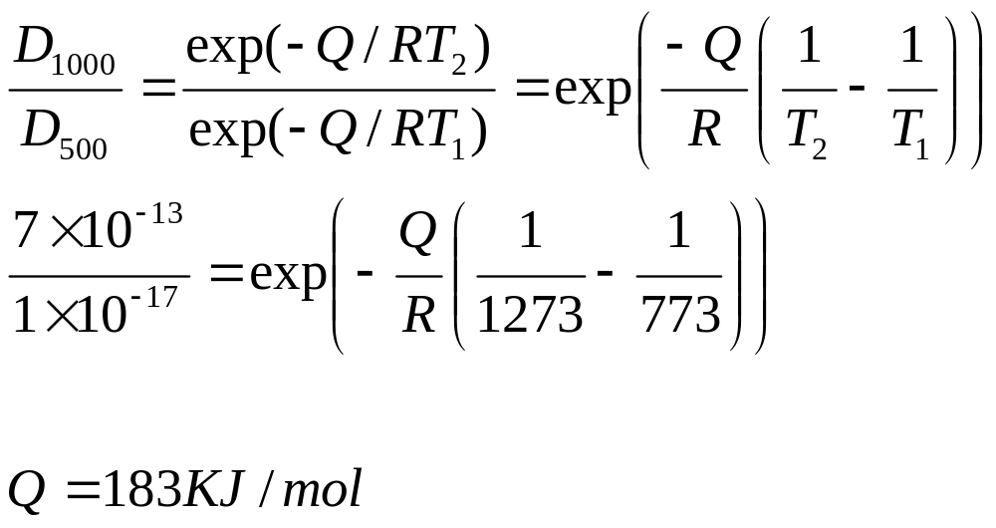
Effect of Temperature on Diffusion-Example
If diffusivity at two temperatures are determined, two equations can be solved for Q and D₀
Example:-
The diffusivity of silver atoms in silver is 1 x 10⁻¹⁷ at 500⁰C and 7 x 10⁻¹³ at 1000⁰C.
Therefore,
Solving for activation energy Q
5-15

Slide 26
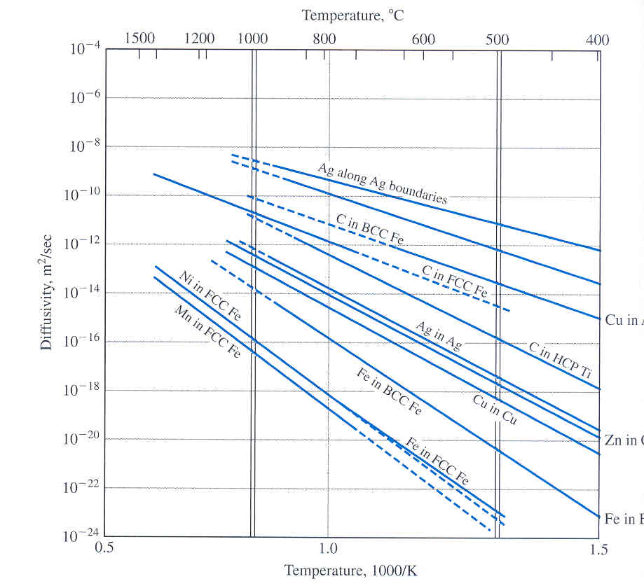
Diffusivity Data for Some Metals
Solute | Solvent | D₀ (M²/S) | Q KJ/mol
Carbon | FCC Iron | 2 x 10⁻⁵ | 142
Carbon | BCC Iron | 22 x 10⁻⁵ | 122
Copper | Aluminum | 1.5 x 10⁻⁵ | 126
Copper | Copper | 2 x 10⁻⁵ | 197
Carbon | HCP Titanium | 51 x 10⁻⁵ | 182
Figure 4.47
5-16
(After L.H. Van Vlack. “Elements of Materials Science and Engineering.” 5th ed., Addison-Wesley, 1985. P.137.)

Slide 27
SUMMARY:
STRUCTURE & DIFFUSION
Diffusion FASTER for...
• open crystal structures
• lower melting T materials
• materials w/secondary
bonding
• smaller diffusing atoms
• lower density materials
Diffusion SLOWER for...
• close-packed structures
• higher melting T materials
• materials w/covalent
bonding
• larger diffusing atoms
• higher density materials

